Slide 1
Artificial Intelligence (AI)

Slide 2
What is Artificial Intelligence (AI)?
Artificial Intelligence is composed of two words Artificial and Intelligence, where Artificial defines "man-made," and intelligence defines "thinking power", hence AI means "a man-made thinking power.“
So, we can define AI as: "It is a branch of computer science by which we can create intelligent machines which can behave like a human, think like humans, and able to make decisions."
AI pioneer Marvin Minsky defined AI as “the science of making machines do things that would require intelligence if done by men”
Artificial Intelligence exists when a machine can have human based skills such as learning, reasoning, and solving problems

Slide 3
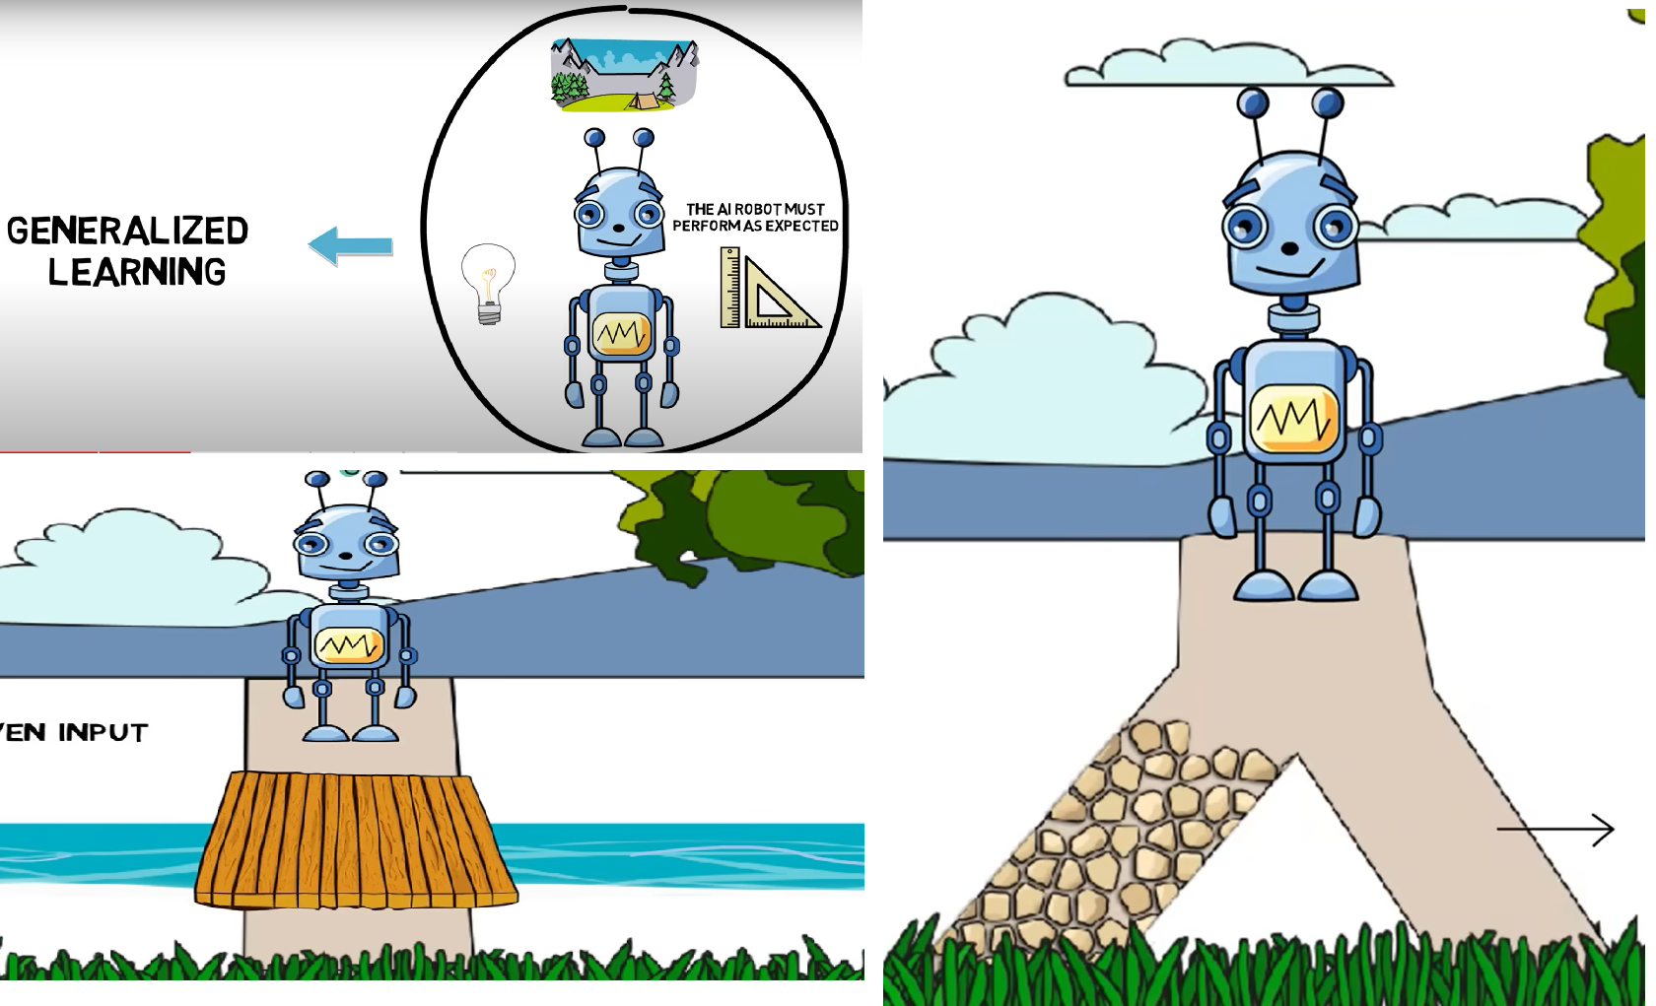
Learning, Reasoning, and Solving problems

Slide 4
Why Artificial Intelligence?
With the help of AI, you can create such software or devices which can solve real-world problems very easily and with accuracy such as health issues, marketing, traffic issues, etc.
With the help of AI, you can create your personal virtual Assistant, such as Cortana, Google Assistant, Siri, etc.
With the help of AI, you can build such Robots which can work in an environment where survival of humans can be at risk.
AI opens a path for other new technologies, new devices, and new Opportunities.

Slide 5
Goals of Artificial Intelligence
Replicate human intelligence
Solve Knowledge-intensive tasks
An intelligent connection of perception and action
Building a machine which can perform tasks that requires human intelligence such as:
Proving a theorem
Playing chess
Plan some surgical operation
Driving a car in traffic
Creating some system which can exhibit intelligent behaviour, learn new things by itself, demonstrate, explain, and can advise to its user.

Slide 6
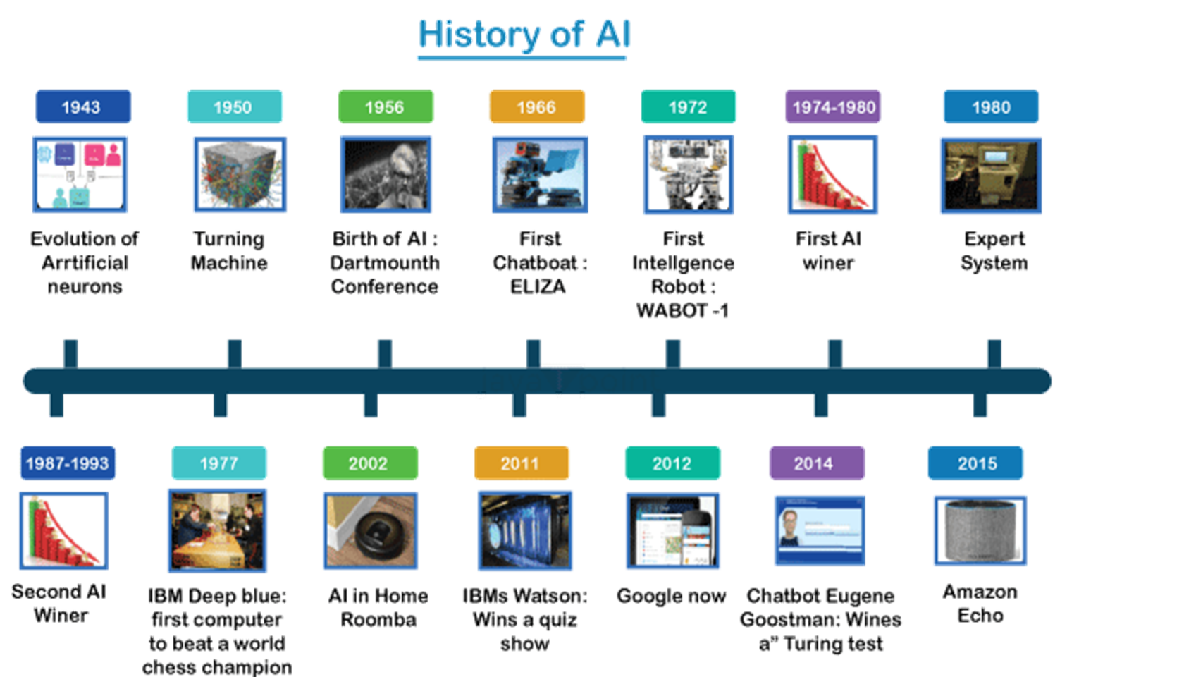
Notes:
https://www.javatpoint.com/history-of-artificial-intelligence

Slide 7
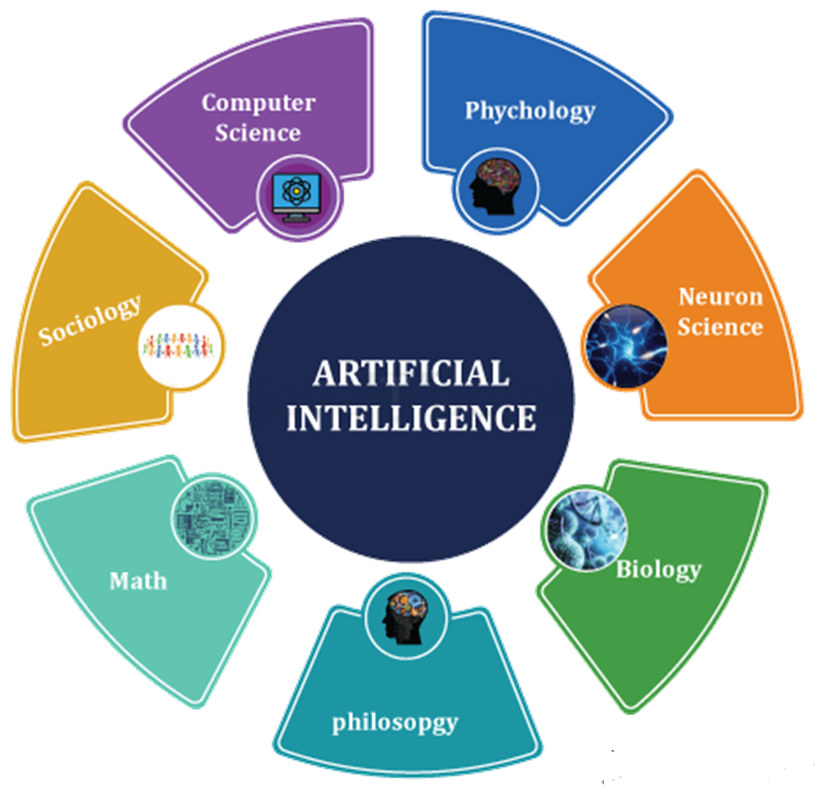
What Comprises to Artificial Intelligence?

Slide 8
Types (Based on Capabilities)
Narrow AI (Weak AI): This type of AI is designed to perform a narrow task (e.g., facial recognition, internet searches, or driving a car). Most current AI systems, including those that can play complex games like chess and Go, fall under this category. They operate under a limited pre-defined range or set of contexts.
General AI (Strong AI): A type of AI endowed with broad human-like cognitive capabilities, enabling it to tackle new and unfamiliar tasks autonomously. Such a robust AI framework possesses the capacity to discern, assimilate, and utilize its intelligence to resolve any challenge without needing human guidance. i.e. Image detection, Smart assistants
Super-intelligent AI: This represents a future form of AI where machines could surpass human intelligence across all fields, including creativity, general wisdom, and problem-solving. Superintelligence is speculative and not yet realized.

Slide 9
Types (Based on Functionalities)
Reactive Machines: These AI systems do not store memories or past experiences for future actions. They analyze and respond to different situations. IBM's Deep Blue, which beat Garry Kasparov at chess, is an example.
Limited Memory: These AI systems can make informed and improved decisions by studying the past data they have collected. Most present-day AI applications, from chatbots and virtual assistants to self-driving cars, fall into this category.
Theory of Mind: This is a more advanced type of AI that researchers are still working on. It would entail understanding and remembering emotions, beliefs, needs, and depending on those, making decisions. This type requires the machine to understand humans truly.
Self-aware AI: This represents the future of AI, where machines will have their own consciousness, sentience, and self-awareness. This type of AI is still theoretical and would be capable of understanding and possessing emotions, which could lead them to form beliefs and desires

Slide 10
Types (Based on Technologies)
Machine Learning (ML): AI systems capable of self-improvement through experience, without direct programming. They concentrate on creating software that can independently learn by accessing and utilizing data.
Deep Learning: A subset of ML involving many layers of neural networks. It is used for learning from large amounts of data and is the technology behind voice control in consumer devices, image recognition, and many other applications.
Natural Language Processing (NLP): This AI technology enables machines to understand and interpret human language. It's used in chatbots, translation services, and sentiment analysis applications.
Robotics: This field involves designing, constructing, operating, and using robots and computer systems for controlling them, sensory feedback, and information processing.
Computer Vision: This technology allows machines to interpret the world visually, and it's used in various applications such as medical image analysis, surveillance, and manufacturing.
Expert Systems: These AI systems answer questions and solve problems in a specific domain of expertise using rule-based systems

Slide 11
Advantages of Artificial Intelligence
High Accuracy with less errors: AI machines or systems are prone to less errors and high accuracy as it takes decisions as per pre-experience or information.
High-Speed: AI systems can be of very high-speed and fast-decision making, because of that AI systems can beat a chess champion in the Chess game.
High reliability: AI machines are highly reliable and can perform the same action multiple times with high accuracy.
Useful for risky areas: AI machines can be helpful in situations such as defusing a bomb, exploring the ocean floor, where to employ a human can be risky.
Digital Assistant: AI can be very useful to provide digital assistant to the users such as AI technology is currently used by various E-commerce websites to show the products as per customer requirement.
Useful as a public utility: AI can be very useful for public utilities such as a self-driving car which can make our journey safer and hassle-free, facial recognition for security purpose, Natural language processing to communicate with the human in human-language, etc.
Enhanced Security: AI can be very helpful in enhancing security, as It can detect and respond to cyber threats in real time, helping companies protect their data and systems.
Aid in Research: AI is very helpful in the research field as it assists researchers by processing and analyzing large datasets, accelerating discoveries in fields such as astronomy, genomics, and materials science

Slide 12
Disadvantages of Artificial Intelligence
High Cost: The hardware and software requirement of AI is very costly as it requires lots of maintenance to meet current world requirements.
Can't think out of the box: Even we are making smarter machines with AI, but still they cannot work out of the box, as the robot will only do that work for which they are trained, or programmed.
No feelings and emotions: AI machines can be an outstanding performer, but still it does not have the feeling so it cannot make any kind of emotional attachment with human, and may sometime be harmful for users if the proper care is not taken.
Increase dependency on machines: With the increment of technology, people are getting more dependent on devices and hence they are losing their mental capabilities.
No Original Creativity: As humans are so creative and can imagine some new ideas but still AI machines cannot beat this power of human intelligence and cannot be creative and imaginative.
Complexity: Making and keeping AI systems can be very complicated and need a lot of knowledge. This can make it hard for some groups or people to use them.
Job Concerns: As AI gets better, it might take away not just basic jobs but also some skilled ones. This worries people about losing jobs in different fields.

Slide 13
Challenges of AI
Doing the Right Thing: AI should make the right choices, but sometimes it doesn't. It can make mistakes or do things that aren't fair. We need to teach AI to be better at making good choices.
Government and AI: Sometimes, governments use AI to keep an eye on people. This can be a problem for our freedom. We need to make sure they use AI in a good way.
Bias in AI: AI can sometimes be a bit unfair, especially when it comes to recognizing people's faces. This can cause problems, especially for people who aren't like the majority.
AI and Social Media: What you see on social media is often decided by AI. But sometimes, AI shows things that aren't true or are kind of mean. We need to make sure AI shows the right stuff.
Legal and Regulatory Challenges: The rapid evolution of AI has outpaced the development of comprehensive laws and regulations, leading to uncertainty about issues like liability and responsibility.

Slide 14
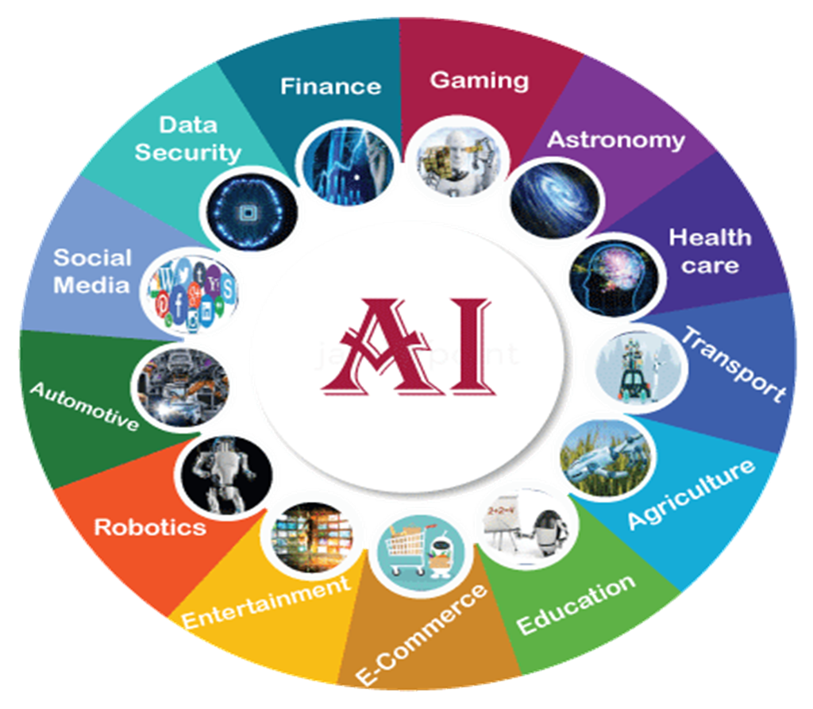
Applications of AI
Notes:
https://www.javatpoint.com/application-of-ai
A student will present #With examples, the application of AI#

